Slide 1

SALES TREND ANALYSIS OF XYZ TRADERS

Slide 2
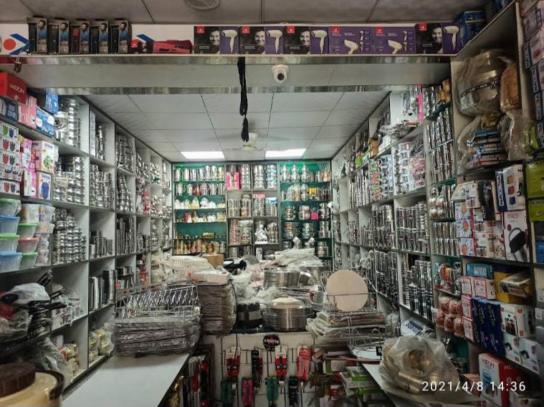
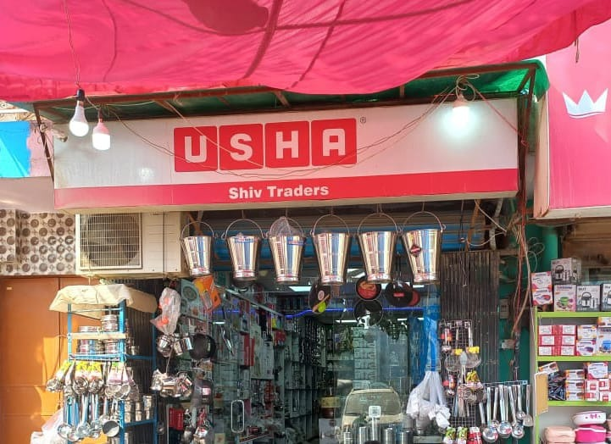

About XYZ Traders
XYZ traders was registered on April 20, 2018
It is a Kitchenware shop located in West Delhi, Delhi, India
They buy products from various distributors and then sell it to the customers.
They have a warehouse for storing products.

Slide 3
Data collection
Process of data collection:
I wanted grocery data but after 4 failures, I requested my friend to share the past 2 months data of his father’s shop for the analysis purpose, but the data was not completed till then so instead he gave me an old data from April 2019 to Feb 2020. The only condition was to maintain anonymity, so I have changed the shop’s name and their distributer.
Structure of the Data:
It has 2 sheets –
“Sales” with 780 rows and the following columns:
DATE
MODE OF PAYMENT
HSN CODE
RATES OF GST
DESCRIPTION
QUANTITY
RATE PER UNIT
TAXABLE AMOUNT
CGST
SGST
IGST
TOTAL AMOUNT
2. “Purchase” with 452 rows and the following columns:
Serial Number
Name of Supplier
Invoice Date
HSN Code
Rate of tax
Description
Quantity
Rate per unit
Gross Amount
Discount
Amount
CGST
SGST
IGST
Total

Slide 4
Analysis and Insights
SS Utensils and MS Strainer are the products which are among the one’s sold in maximum quantity and also generate maximum profit.
Out of 212 products, only 23 products contribute to 50% of the revenue generated.
Supplier ‘H’ is the most preferred supplier and 8 suppliers out of 23 covered around 80% of the shop’s purchase.
Kenstar Cooler have the maximum margin and hence most profitable.
Product Name | Sale Price | Purchase Price | Margin
Kenstar Cooler Slimline Super | ₹ 8,474.58 | ₹ 6,610.19 | ₹ 1,864.39
GS CS3B Black | ₹ 3,305.08 | ₹ 2,025.43 | ₹ 1,279.65
T- Series Cooler TST-707 70 Ltr HC | ₹ 7,796.61 | ₹ 6,780.51 | ₹ 1,016.10
T- Series Cooler TST-550 55 Ltr HC | ₹ 6,949.15 | ₹ 5,941.52 | ₹ 1,007.63
Supplier | No of purchases | Cumulative purchases | Cumulative purchase %
H | 70 | 70 | 15.63%
C | 62 | 132 | 29.46%
D | 61 | 193 | 43.08%
F | 59 | 252 | 56.25%
G | 40 | 292 | 65.18%
B | 36 | 328 | 73.21%
A | 20 | 348 | 77.68%
E | 17 | 365 | 81.47%

Slide 5
Analysis and Insights
Monthly Sales Trend from April 2019 to Feb 2019 shows that October has the maximum sales while the months near to this shows slight decline and the reason behind this could be Dhanteras as the highest sales in October were on October 25, 2019: The day of Dhanteras.
In the whole year there were few products which remained unsold. Some of them were bought again without selling the previous stock.
Products which were not sold in the whole year
Product | Purchased Quantity
Fan Somete 2.5 1200 Brown | 72
LED Adore 13W B22 CDL 4 Star Ball Lamp | 40
Fans FAB 600 Brown | 32
DT-10 Peeling Knife Small | 30
KHR Dynor Utility Box Small | 25
Link Pad Lock Round 65MM BCP | 25
Link Pad Lock Round 50MM BCP | 25
Fire Gas Lighter With Knife | 25
Paring Knives | 25
Edge 1200mm Brown CF | 24
SS Utensils(Spoon) | 23.74
Nano Knife Edge | 20
20W T5 60K Batten | 20
DT-13 Peeling Knife Larger | 20
LED Adore 3W B22 CDL Ball Lamp | 20

Slide 6
Recommendation
Try to switch to CASH REGISTER because:
There were some products which were bought again before even selling the previous stock. The reason when asked was either the product was misplaced in the warehouse or the purchase slip was lost and hence they were not able to store the data.
Providing small discounts or schemes:
Specially in September like shop for Rs. 4000+ products now and get 10% off on Dhanteras can be beneficial because the sales before and after Dhanteras are low. Most of the large margin products will lie in Rs. 4000+ category and hence will not affect the profit much. Not only that because of such schemes people will prefer to buy from this shop on Dhanteras leading to more profit.

Slide 7
THANK YOU !!

